Slide 1
Lecture 5
System Calls a.k.a.
Crossing the OS boundary safely

Slide 2
Obtaining System Services
Any application requiring a resource under OS care must request for it using the proper API
Security an issue: how to ensure the OS boundary is crossed safely?

Slide 3
Typical OS services
File services: create, open, read, write, close
Terminal I/O
Network processing
Memory allocation, protection etc.

Slide 4
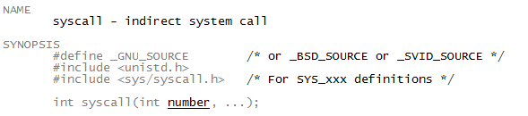
syscall()
Typically, system calls wrapped in library API (such as file I/O)
To call directly, need to use syscall() library function

Slide 5
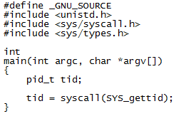
syscall() example

Slide 6
System calls in Linux
System calls in Linux is identified by its number
Example: To read from an opened file requires the read system call. It is __NR_read
3 in /usr/include/asm/unistd_32.h (32 bit systems)
0 in /usr/include/asm/unistd_64.h (64 bit systems)

Slide 7
x86 system calls – the old way
Uses a software interrupt
int 0x80
Uses the interrupt servicing mechanism to elevate privileges to Ring 0
But found to be slow
There are more things that need to be done to service interrupts in general

Slide 8
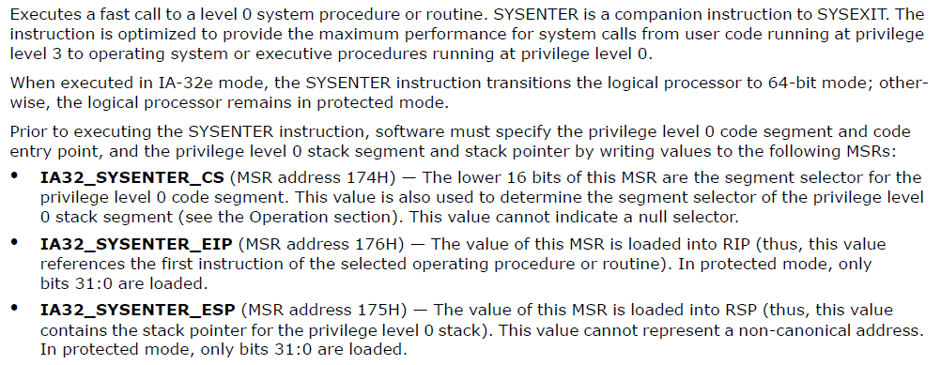
The new x86 way
Uses the SYSENTER/SYSEXIT instructions

Slide 9
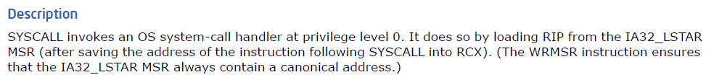
In 64 bits: SYSCALL/SYSRET
Introduced by AMD but now also supported in Intel64
Both SYSENTER and SYSCALL allows for a disciplined transition from Ring 3 to Ring 0
Just how to set up the context is done differently

Slide 10
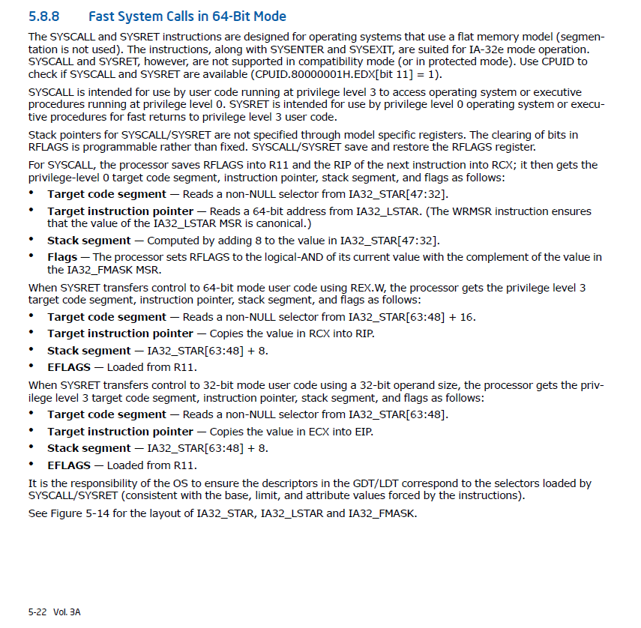
From the Intel Manual

Slide 11
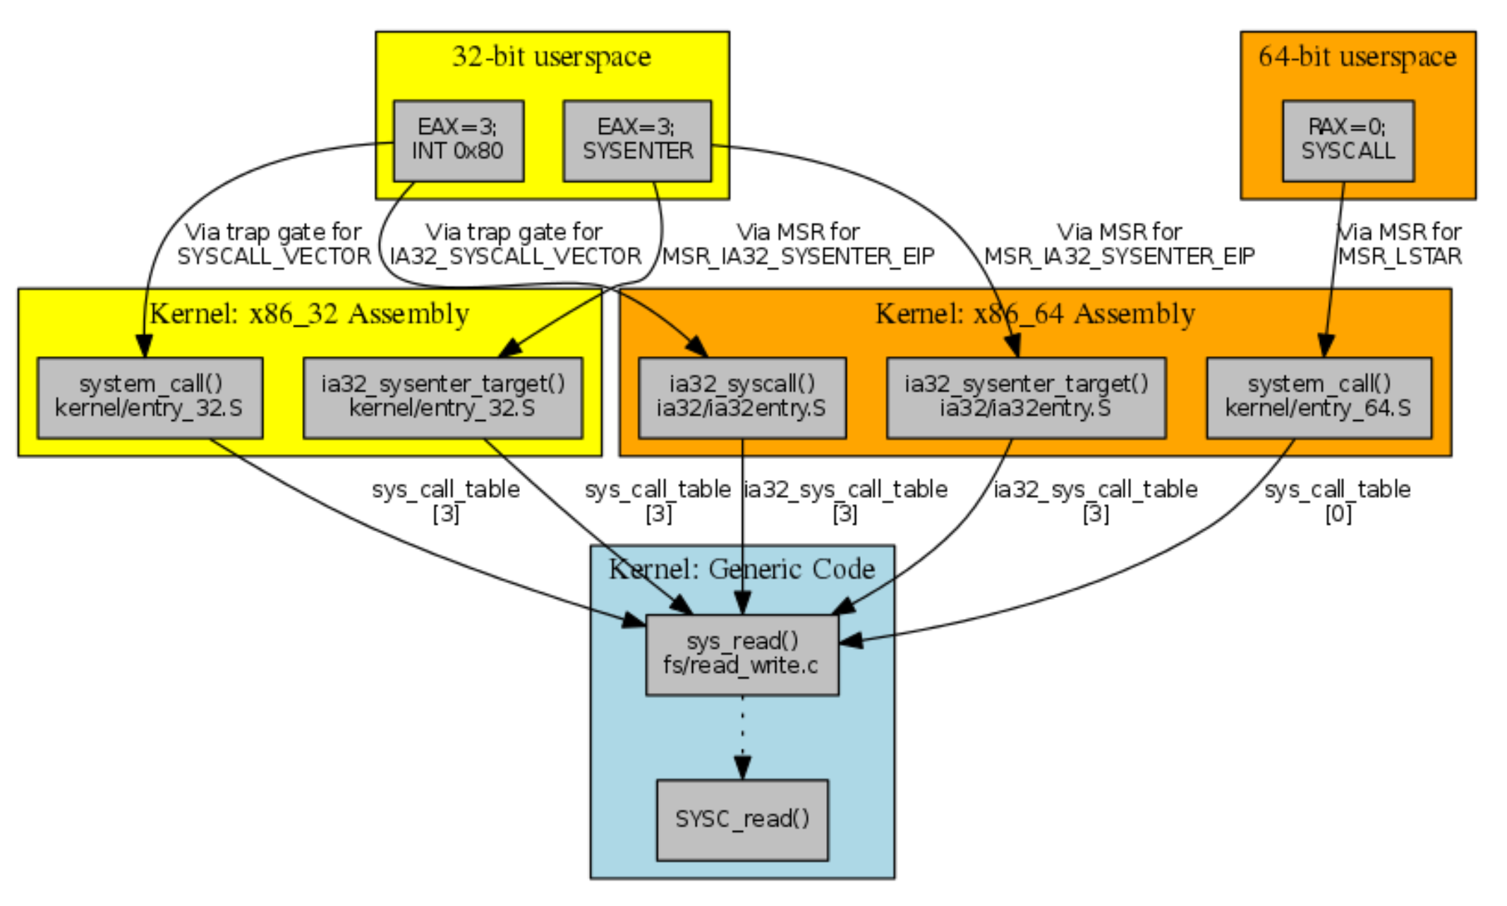
In Linux
__NR_read
Note: In Linux 64-bit, you can run a 32-bit binary. Some compatibility processing is then needed to get the 32-bit binary to request for service in a 64-bit kernel.
Source: https://lwn.net/Articles/604515/

Slide 12
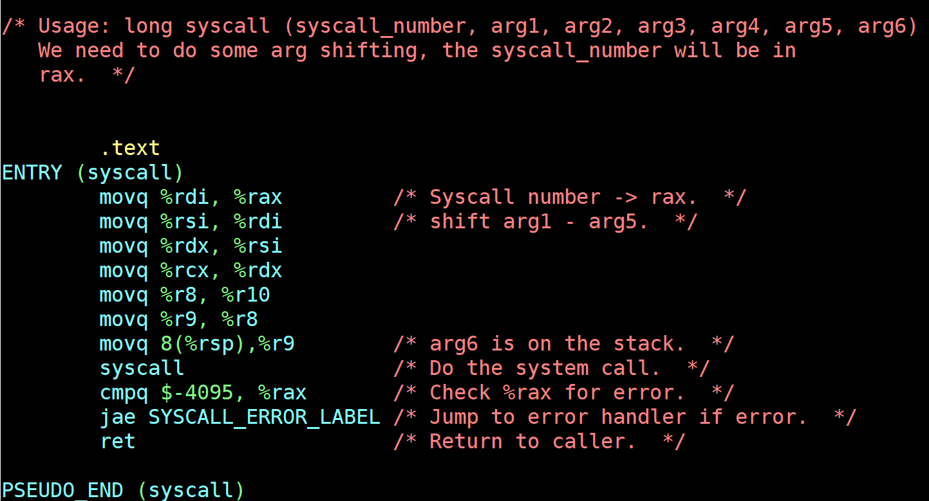
In Linux
glibc-2.29/sysdeps/unix/sysv/linux/x86_64/syscall.S

Slide 13
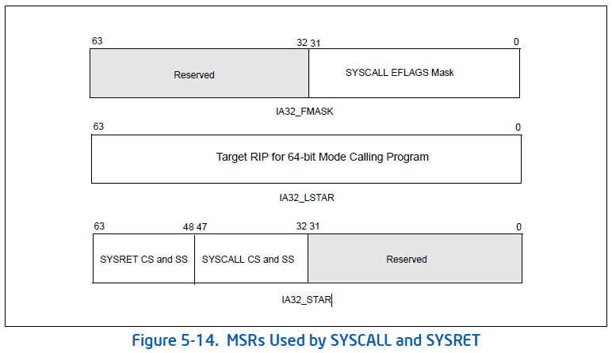
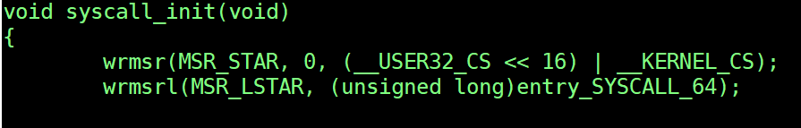
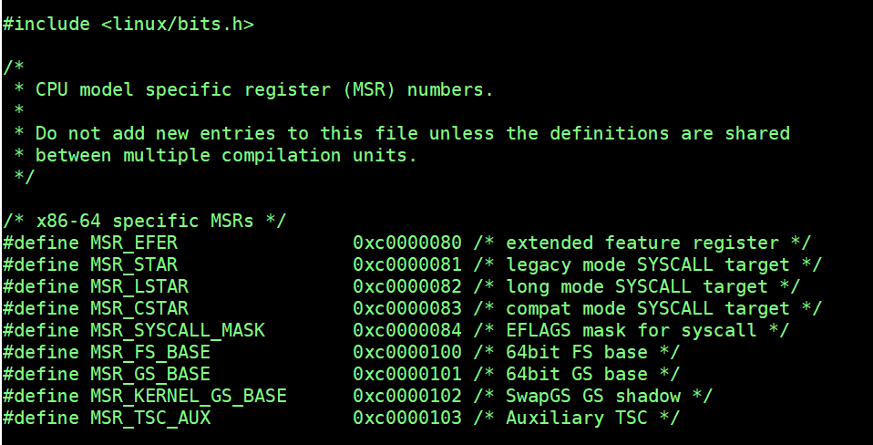
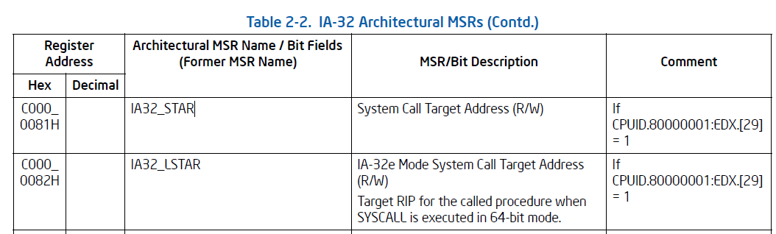
In Linux
arch/x86/kernel/cpu/common.c
arch/x86/include/asm/msr-index.h

Slide 14
A small digression: x86 Model Specific Registers
Special control “registers” in the x86 instruction set used for debugging, execution tracing, computer performance monitoring, and operating certain CPU features
They may or may not be implemented in the processor you have at hand
Need to check the model

Slide 15
Using the MSR
Use rdmsr to read a MSR
EDX:EAX = MSR[ECX]
Use wrmsr to write a MSR
MSR[ECX] = EDX:EAX
Must first confirm a particular MSR’s existence using the (complicated) cpuid instruction

Slide 16
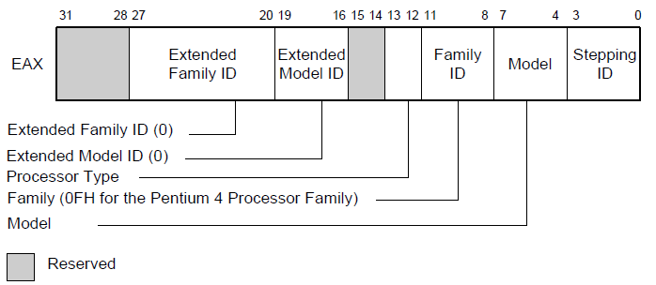
Digression of a digression: CPUID
Bit 21 (ID bit) of EFLAGS must be 1 to indicate support for CPUID
Put a value in EAX for a query code
Values returned in various registers (read the manual)
Input EAX = 1

Slide 17
Linux system calls
A table of system call service routines is maintained by the kernel
sys_call_table[] in arch/x86/entry
Note: it is autogenerated at kernel build time from arch/x86/entry/syscalls/syscall_{32|64}.tbl
The index to the table is the assigned system call number
arch/x86/entry/common.c contains the dispatch code – after SYSENTER/SYSCALL
Wrapped in a bit of assembly code in entry_{32|64}.S

Slide 18
Summary
There are only two ways to enter the kernel
Via interrupt
Using SYSCALL/SYSENTER
Important difference: a system call always transits from user to kernel mode, while an interrupt/exception/trap can happen even inside Ring 0
In 64-bit, Linux expects user to enter the kernel only by the use SYSCALL instructions
SYSENTER is used only in 32-bit Linux

Slide 19
Important digressions

Slide 20
Stacks everywhere
The modern Linux kernel is multithreaded
Need stacks to operate
No stack, no procedure call
If use user stack, security risk
Interrupts and stacks can happen any time

Slide 21
The stacks used by the kernel
Per thread kernel stack
Entry trampoline stack
Interrupt Stack
Hard IRQ Stack
Soft IRQ Stack

Slide 22
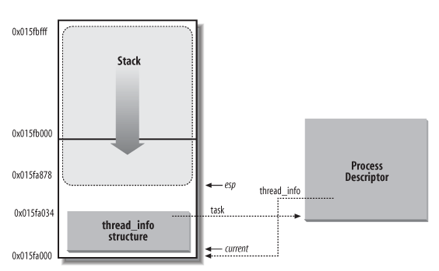
Per thread kernel stack
16KB
It is in the task_struct of each process
Grows towards the thread_info structure

Slide 23
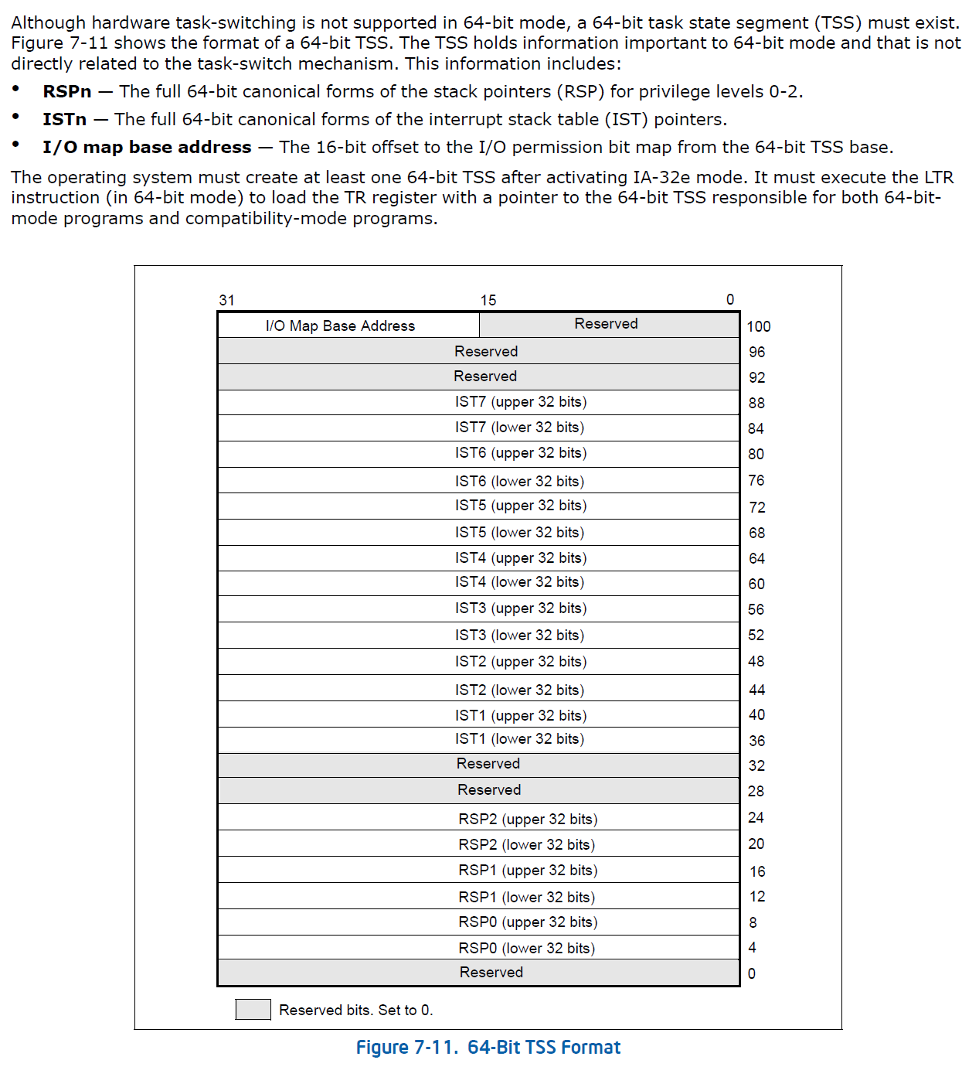
Task State Segment
Intel architecture provisions for OS tasks
Hardware task switching not supported in 64 bit mode
Consists of pointers to stacks
7 IST stacks for interrupt service routine usage
One for each protection ring
RSP0 – entry trampoline stack
RSP1 – current top of kernel stack
RSP2 – scratch to contain user stack pointer on SYSCALL

Slide 24
TSS in Linux
arch/x86/include/asm/cpu_entry_area.h
Defines the (per) CPU entry area that includes the TSS
arch/x86/include/asm/processor.h
Actual definition of the TSS
Linux only has one TSS for each CPU and uses them for all tasks

Slide 25
Page Table Isolation
Full set of kernel page tables use to coexist with user page tables
Potential security loophole!
Two separate sets (duplicates) of kernel page tables
The full one
A minimal one in the user space just sufficient to transit to the kernel
Implemented on Linux 4.15 onwards

Slide 26
Details of SYSCALL

Slide 27
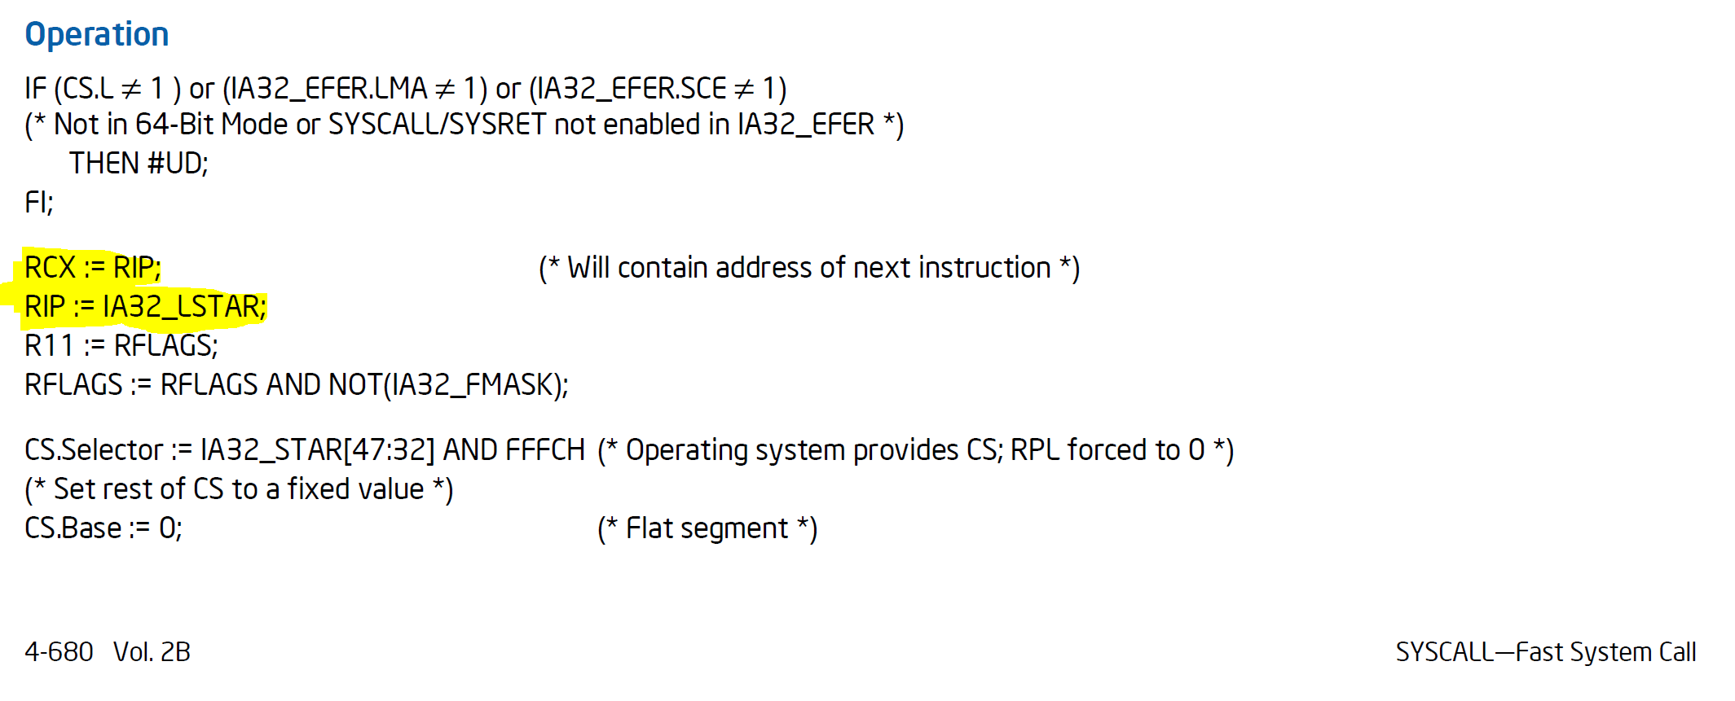
Hardware execution
What the Intel manual says:
arch/x86/kernel/cpu/common.c:1752

Slide 28
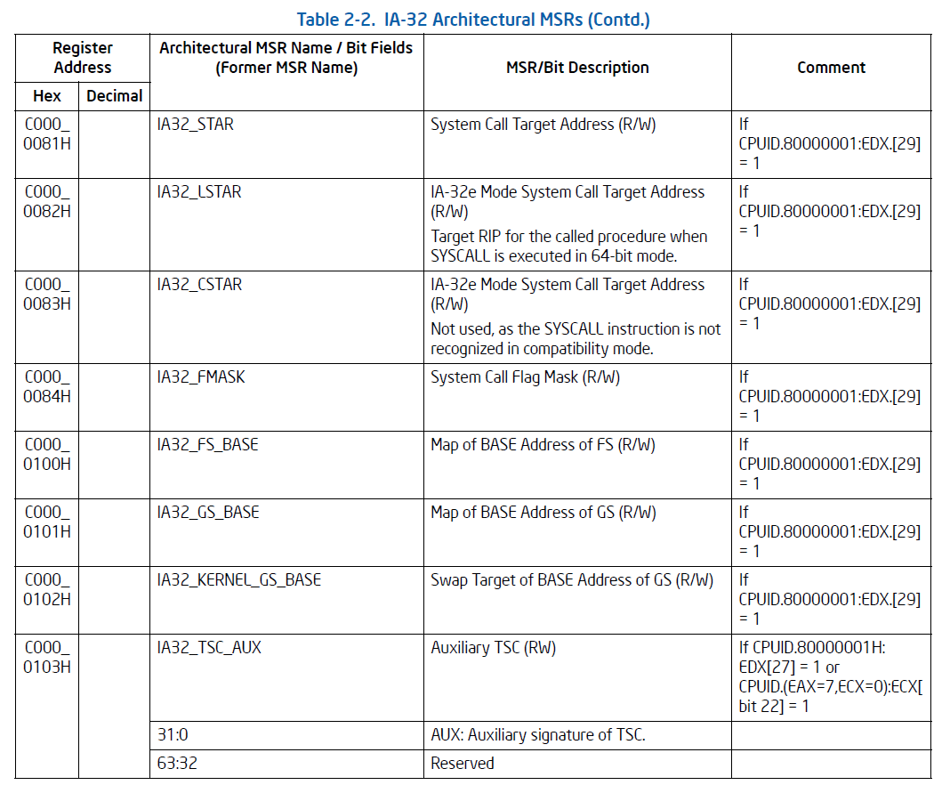
Model Specific Registers (MSR)
MSRs are used to control and report on processor performance
Virtually all MSRs handle system related functions and are not accessible to an application program
One exception to this rule is the time-stamp counter
Accessed using RDMSR and WRMSR privileged instructions

Slide 29
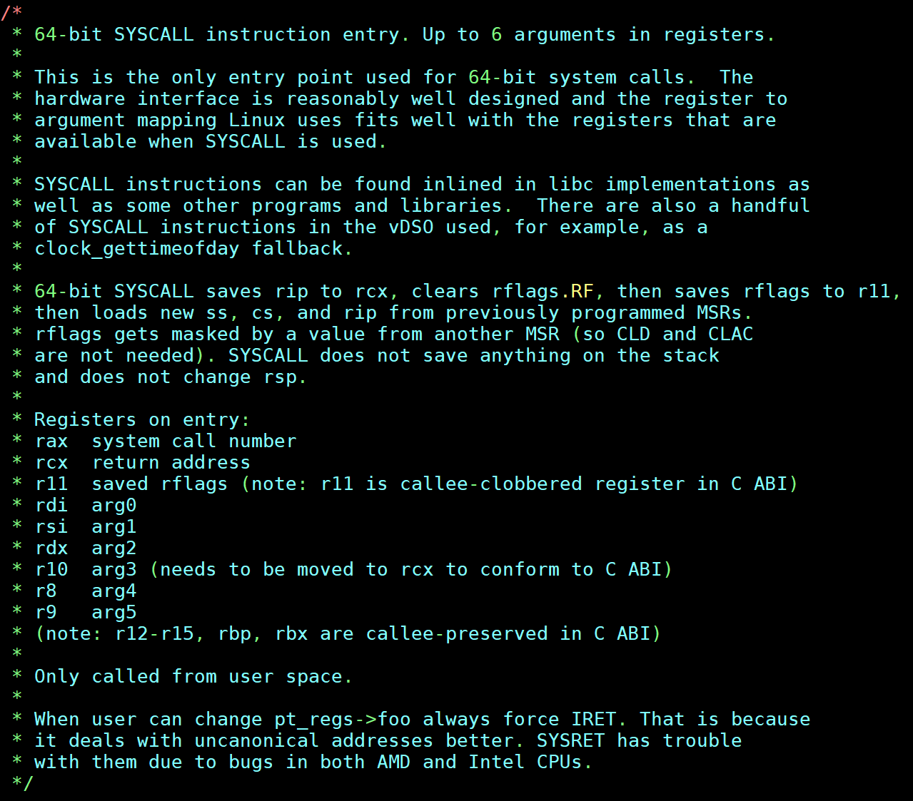
arch/x86/entry/entry_64.S
Pt_regs is the structure for saving all registers.
Defined in arch/x86/include/uapi/asm/ptrace.h

Slide 30
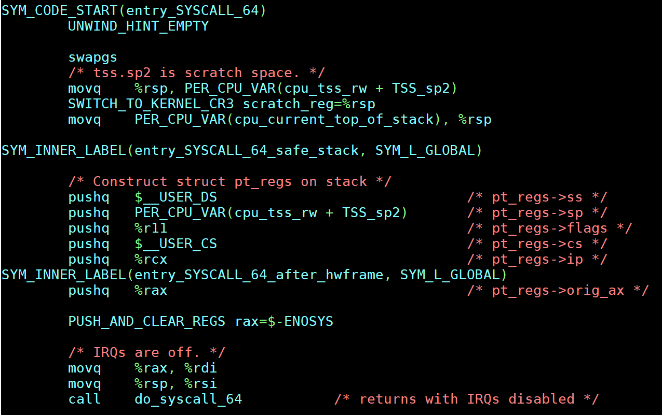
arch/x86/entry/entry_64.S
Code written in assembly can do funky things to the stack. This makes it hard for debugging tools to follow the stack frame properly as they don’t follow the proper calling convention. This is a macro that gives “hints” to such debuggers.
See: DWARF debugging file format standard specifications: https://dwarfstd.org/

Slide 31
arch/x86/entry/entry_64.S
GS segment register is used for quick access to the per CPU region so as to get the per-CPU variables quickly .

Slide 32
FS and GS in Intel 64 bit mode
In 64-bit mode, FS and GS segment registers’ base address is 64 bits
Full segmentation is not available but you can use FS and GS as 64 bit base registers
Use in Linux:
FS points to thread local storage
GS points to per CPU data structure
New 64-bit instructions to write to FS and GS segment base
wrfsbase, wrgsbase

Slide 33
swapgs
GS is associated with a special control register MSR at address 0xC0000102
Intel manual calls this the IA32_KERNEL_GS_BASE MSR
Only accessible in Ring 0
swapgs – a privileged instruction that will swap the current value of GS with IA32_KERNEL_GS_BASE MSR

Slide 34
arch/x86/entry/entry_64.S
saves the user mode stack pointer into a scratch location, namely the sp2 of the TSS which is also not used since Ring 2 is not used.

Slide 35
arch/x86/entry/entry_64.S
Restore the full kernel page table.
Use %rsp as a scratch since it was already saved up.

Slide 36
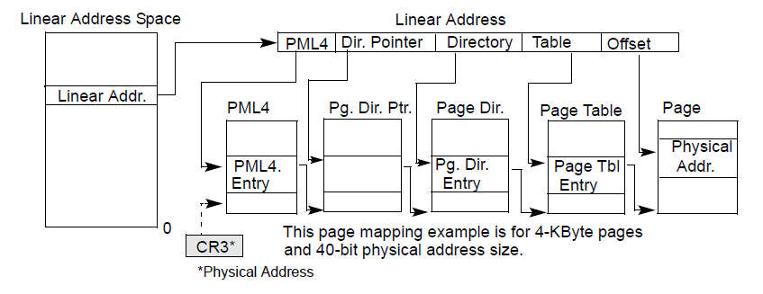
Recall: Paging and CR3

Slide 37
arch/x86/entry/entry_64.S
Switch to true kernel stack.

Slide 38
arch/x86/entry/entry_64.S
Saves (some) registers to pt_regs.

Slide 39
arch/x86/entry/entry_64.S
Call the service dispatcher.

Slide 40
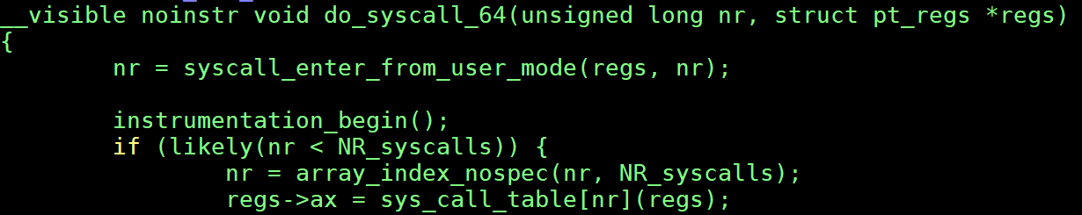
arch/x86/entry/common.c

Slide 41
Speeding up system calls (1)
vsyscall

Slide 42
vsyscall
Certain system calls can get called very often
How to speed it up even faster?
Key: do not actually enter the kernel

Slide 43
Executing system call in userspace
Linux kernel maps a page containing some kernel variables and implementation of some system calls into the user space
Key: read only!

Slide 44
Nuts and bolts
Mapping of the vsyscall page occurs in the map_vsyscall function that is defined in the arch/x86/entry/vsyscall/vsyscall_64.c
This is called during kernel initialization

Slide 45
Read only
Used to be done for gettimeofday(), time() and getcpu()
All read only functions
The vsyscall page contains the variables involved and the small amount of (kernel) code to read them
Page is readable, executable but not writable

Slide 46
Deprecated!
Now deemed too dangerous!
Exposing a kernel physical page to the all user processes at a fixed known address

Slide 47
Speeding up system calls (2)
Virtual Dynamic Shared Object

Slide 48

vDSO
Also same idea as vsyscall but allow linker to do address space randomization (ASR) and place the page anywhere in the virtual space
Example from two different processes:

Slide 49
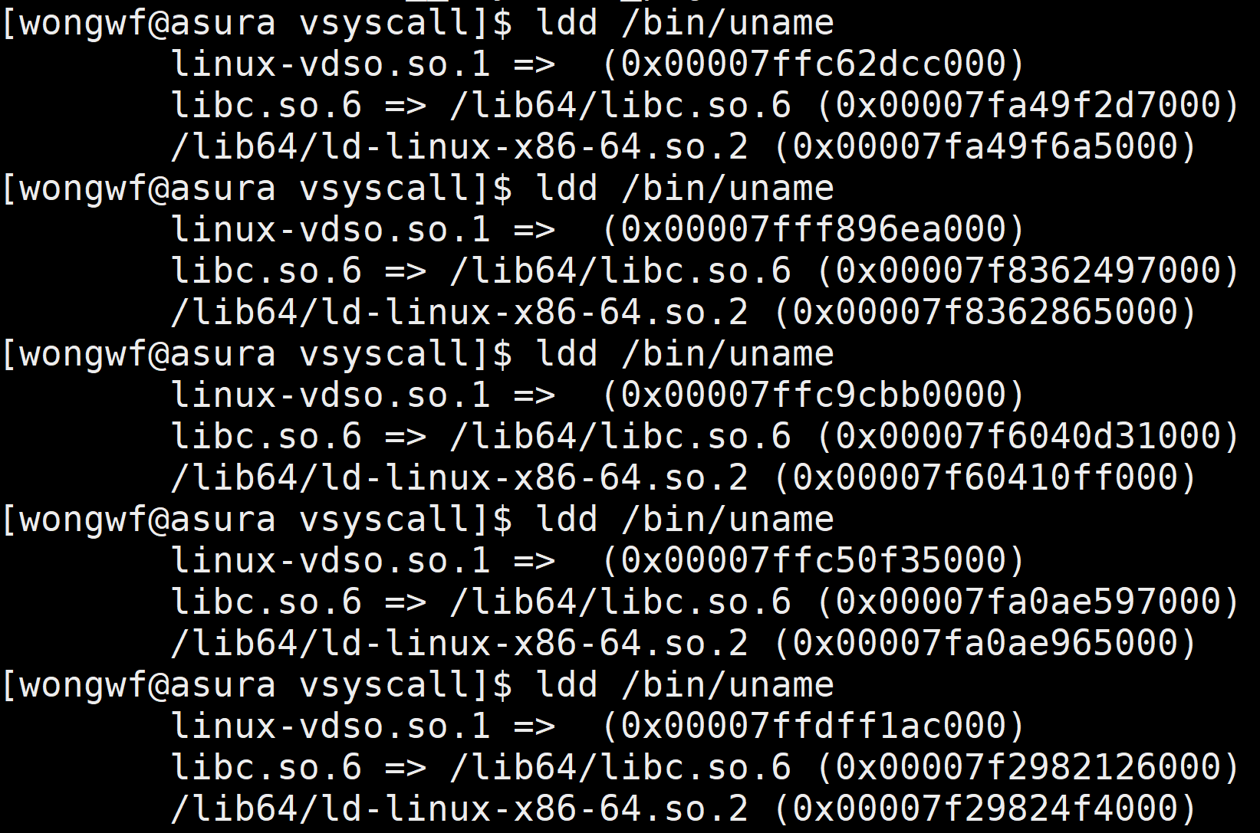
vDSO object
No associated file object

Slide 50
vDSO object
Address
randomized

Slide 51
Kernel-GLIBC
Kernel provide the dynamic shared object to the loader
vdso{32|64}.so in arch/x86/entry/vdso
Kernel detects loading of shared executable, will then provide the shared object in the process image
No file object
Final setup done by glibc ELF startup code

Slide 52
What’s inside vDSO?
Sources are in arch/x86/entry/vdso
Contains:
__vdso_clock_gettime
__vdso_clock_getres
__vdso_getcpu
__vdso_gettimeofday
__vdso_time

Slide 53
END

